Slide 1
SQL

Slide 2
Introduction to SQL
What is SQL?
When a user wants to get some information from a database file, he can issue a query.
A query is a user–request to retrieve data or information with a certain condition.
SQL is a query language that allows user to specify the conditions. (instead of algorithms)

Slide 3
Concept of SQL
The user specifies a certain condition.
The program will go through all the records in the database file and select those records that satisfy the condition.(searching).
Statistical information of the data.
The result of the query will then be stored in form of a table.

Slide 4
The SQL Standard
• SQL – Structured Query Language
a ‘standard’ that specifies how
a relational schema is created
data is inserted / updated in the relations
data is queried
transactions are started and stopped
programs access data in the relations
• Every relational database management system (RDBMS) is required to support / implement the SQL standard.
Pronounced as “S-Q-L” or “Sequel.”

Slide 5
SQL Continued
Based on relational algebra, but not entirely identical.
Relations ⇔ Tables
Tuples ⇔ Rows
Attributes ⇔ Columns
Unlike a relation, a table is not a set. Duplicates are not automatically removed.
This is for practical reasons. Duplicate eliminations are inefficient in implementation.
Like a relation, the order of rows in a table is irrelevant.

Slide 6
Domain Types in SQL
Numeric data types
• integers of various sizes – INT, SMALLINT
• real numbers of various precision –REAL, FLOAT,
DOUBLE PRECISION
• formatted numbers – DECIMAL ( i, j ) or NUMERIC ( i, j )
i – total number of digits ( precision )
j – number of digits after the decimal point ( scale )
Character string data types
• fixed length –CHAR(n) – n: no. of characters
• varying length – VARCHAR(n) – n: max.no. of characters

Slide 7
Date data type
DATE type has 10 position format – YYYY-MM-DD
Time data type
TIME type has 8 position format – HH : MM : SS
Other
BLOB: Images
Bit string data types
fixed length –BIT(n)
varying length –BIT VARYING(n)

Slide 8
BASIC SQL COMMANDS
CREATING A TABLE
Syntax:
Create table <Table Name>
( <Field1> <Type> <(width)> Constraint <constraint name> Primary Key,
<Field2> <Type> <(width)>,
..................................) :

Slide 9
BASIC SQL COMMANDS
CREATING A TABLE
Example:
Create table student
(id int ,
Name Varchar(25),
Class Varchar (5)
);
ID | Name | Class

Slide 10
BASIC SQL COMMANDS
Inserting in table
Syntax:
Insert into <Table Name> values
(value of column 1,
value of column 2,
….. ,
value of column n);

Slide 11
BASIC SQL COMMANDS
Inserting in table
Example:
insert into student values(1, ‘student 1’, ‘cse’);
insert into student values(2, ‘student 2’, ‘ese’);
insert into student values(3, ‘student 3’, ‘IT’);
ID | Name | Class
1 | Student 1 | cse
2 | Student 2 | ece
3 | Student 2 | IT

Slide 12
BASIC SQL COMMANDS
querying table
SELECT
FROM table
WHERE [conditions]
ORDER BY [columns]
;
Defines the end of an SQL statement
Some programs require it, some do not
Needed only if multiple SQL statements run in a script

Slide 13
Basic SQL Commands
SELECT
FROM table
WHERE [conditions]
ORDER BY [columns]
;
Defines the end of an SQL statement
Some programs require it, some do not
Needed only if multiple SQL statements run in a script

Slide 14
BASIC SQL COMMANDS
querying table
ID | Name | Class
1 | Student 1 | cse
2 | Student 2 | ece
3 | Student 2 | IT
Example:
Select id from student ;
Out put:
ID
1
2
3

Slide 15
BASIC SQL COMMANDS
querying table
ID | Name | Class
1 | Student 1 | cse
2 | Student 2 | ece
3 | Student 2 | IT
Example:
Select id from student where class = ‘cse’ ;
Out put:
ID
1

Slide 16
SQL: DELETE Statement
To delete rows from the table:
DELETE statement syntax:
DELETE FROM <table name>
WHERE <condition>;

Slide 17
SQL: DELETE Statement
Example: DELETE FROM student
WHERE batch = ‘ece’;
Remaining Table
ID | Name | Class
1 | Student 1 | cse
2 | Student 2 | ece
3 | Student 2 | IT
ID | Name | Class
1 | Student 1 | cse
3 | Student 2 | IT

Slide 18
SQL: DELETE Statement
Example: DELETE FROM student
Output
ID | Name | Class
1 | Student 1 | cse
2 | Student 2 | ece
3 | Student 2 | IT
ID | Name | Class

Slide 19
SQL: UPDATE Statement
To update the content of the table:
UPDATE statement syntax:
UPDATE <table name> SET <column> = <value>
WHERE <selection condition>;

Slide 20
SQL: UPDATE Statement
To update the content of the table:
Example: UPDATE student SET id = 9
WHERE class = ‘IT’
Output:
ID | Name | Class
1 | Student 1 | cse
2 | Student 2 | ece
3 | Student 2 | IT
ID | Name | Class
1 | Student 1 | cse
2 | Student 2 | ece
9 | Student 2 | IT

Slide 21
SQL: Alter table
To change structure of the table:
Add column
Drop column
Change data type of column
…
Syntax: ALTER TABLE <table> <action>

Slide 22
SQL: ALTER Statement
Example: ALTER TABLE abc.student
ADD batch VARCHAR(20) AFTER CLASS;
Output:
ID | Name | Class
1 | Student 1 | cse
2 | Student 2 | ece
3 | Student 2 | IT
ID | Name | Class | Batch
1 | Student 1 | cse
2 | Student 2 | ece
9 | Student 2 | IT

Slide 23
SQL: ALTER Statement
Example: ALTER TABLE abc.student
DROP CLASS;
Output:
ID | Name | Class | Batch
1 | Student 1 | cse
2 | Student 2 | ece
9 | Student 2 | IT
ID | Name | Batch
1 | Student 1
2 | Student 2
9 | Student 2

Slide 24
SQL: ALTER Statement
Example: ALTER TABLE student
ADD `roll_no` INT FIRST;
Output:
ID | Name | Class | Batch
1 | Student 1 | cse
2 | Student 2 | ece
9 | Student 2 | IT
Roll_ No | ID | Name | Batch
 | 1 | Student 1
 | 2 | Student 2
 | 9 | Student 2

Slide 25
SQL: Primary Key Constraint
It uniquely identifies each row of the tables
More than one can be specified in a primary key i.e., composite primary key
Can be added at the time of CREATE TABLE or ALTER TABLE

Slide 26
SQL: Primary Key Constraint
CREATE TABLE syntax
CREATE TABLE student (
id INT,
name VARCHAR(20),
class VARCHAR(20),
PRIMARY KEY (id)
) ;

Slide 27
SQL: Primary Key Constraint
ALTER TABLE syntax
ALTER TABLE student ADD PRIMARY KEY (id);
ALTER TABLE student ADD PRIMARY KEY (id, name);
ID | Name | Class | Batch
1 | Student 1 | cse
2 | Student 2 | ece
9 | Student 2 | IT

Slide 28
CHECK constraint
CHECK cond where cond is:
Boolean expression evaluated using the values in the row being inserted or updated, and
Multiple CHECK constraints
No limit on the number of CHECK constraints you can define on a column
CREATE TABLE credit_card(
....
balance int NOT NULL,
CHECK( balance >= 0),
CHECK (balance < limit),
....
)

Slide 29
SQL: Other queries
MIN , MAX
SELECT MIN(column_name) FROM table_name WHERE condition
Output: will give the minimum value

Slide 30
SQL: Other queries
COUNT, AVG, SUM
The COUNT() function returns the number of rows that matches a specified criteria.
The AVG() function returns the average value of a numeric column.
The SUM() function returns the total sum of a numeric column.

Slide 31
SQL: Other queries
COUNT, AVG, SUM
Select count(id) from table1 :
4
Select sum(id) from table1:
7
Select avg(id) from table1:
1.7500
id
1
2
1
3

Slide 32
SQL: Other queries
COUNT, AVG, SUM
What will happen if there is a blank or null entry?

Slide 33
SQL: order by queries
id
1
2
1
3
ascending or descending
select id from table1 order by id asc
select id from table1 order by id desc
id
1
1
2
3
id
3
2
1
1

Slide 34
SQL: group by queries
The GROUP BY Clause is used to group rows with same values .
SELECT column-names
FROM table-name
WHERE condition
GROUP BY column-names

Slide 35
SQL: group by queries
The GROUP BY Clause is used to group rows with same values .
SELECT COUNT(Id), Country
FROM Customer
GROUP BY Country
Output:
id | country
1 | India
2 | USA
3 | India
4 | India
id | country
3 | India
1 | USA

Slide 36
SQL: HAVING queries
The HAVING clause was added to SQL because the WHERE keyword could not be used with aggregate functions
SELECT column_name(s) FROM table_name WHERE condition GROUP BY column_name(s) HAVING condition ORDER BY column_name(s);

Slide 37
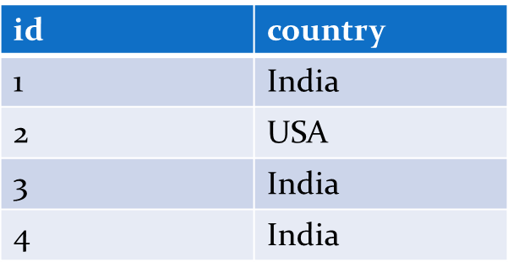
SQL: HAVING queries
The HAVING clause was added to SQL because the WHERE keyword could not be used with aggregate functions
SELECT COUNT(CustomerID), Country FROM Customers GROUP BY Country HAVING COUNT(CustomerID) > 2;
Output:
COUNT(id) | country
3 | India

Slide 38
What is the difference between “Where” and “Having”?

Slide 39
Basic DDL Commands in SQL
CREATE: to define new tables (to define relation schemas)
DROP: to delete table definitions (to delete relation schemas)
ALTER: to change the definitions of existing tables (to change relation schema)
Other features as DDL
Specify referential integrity constraints (FKs)
Specify user-defined attributes constraints

Slide 40
BASIC SQL COMMANDS
CREATING A TABLE WITH COMPOSITE PK
Syntax:
Create table <Table Name>
( <Field1> <Type> <(width)> ,
<Field2> <Type> <(width)>,
..................................<field-n> <type-n> <width-n>,
Constraint <constraint-name> Primary Key (Field1, Field2)) :
Example:
Create table student_table3
(
Reg_no int, Name varchar (25), Class varchar (5),
Constraint student_Reg_Class_pk primary key (Reg_no, Class)
);

Slide 41
Integrity Constraints
Purpose: prevent semantic inconsistencies in data
e.g.:
e.g.:
No entry for Kenmore...
???
3 kinds of IC’s:
1. Key Constraints
2. Attribute Constraints
3. Referential Integrity Constraints

Slide 42
IC’s
What are they?
predicates on the database
must always be true (:, checked whenever db gets updated)
There are the following 3 types of IC’s:
Key constraints (1 table)
e.g., 2 accts can’t share the same acct_no
Attribute constraints (1 table)
e.g., 2 accts must have nonnegative balance
Referential Integrity constraints ( 2 tables)
E.g. bnames associated w/ loans must be names of real branches

Slide 43
Key Constraints
Idea: specifies that a relation is a set, not a bag
SQL examples:
1. Primary Key:
CREATE TABLE branch(
bname CHAR(15) PRIMARY KEY,
bcity CHAR(20),
assets INT);
or
CREATE TABLE depositor(
cname CHAR(15),
acct_no CHAR(5),
PRIMARY KEY(cname, acct_no));
2. Candidate Keys:
CREATE TABLE customer (
ssn CHAR(9) PRIMARY KEY,
cname CHAR(15),
address CHAR(30),
city CHAR(10),
UNIQUE (cname, address, city);

Slide 44
Key Constraints
Effect of SQL Key declarations
PRIMARY (A1, A2, .., An) or
UNIQUE (A1, A2, ..., An)
Insertions: check if any tuple has same values for A1, A2, .., An as any
inserted tuple. If found, reject insertion
Updates to any of A1, A2, ..., An: treat as insertion of entire tuple
Primary vs Unique (candidate)
1 primary key per table, several unique keys allowed.
Only primary key can be referenced by “foreign key” (ref integrity)
DBMS may treat primary key differently
(e.g.: implicitly create an index on PK)
4. NULL values permitted in UNIQUE keys but not in PRIMARY KEY

Slide 45
Attribute Constraints
Idea:
Attach constraints to values of attributes
Enhances types system (e.g.: >= 0 rather than integer)
In SQL:
1. NOT NULL
e.g.: CREATE TABLE branch(
bname CHAR(15) NOT NULL,
....
)
Note: declaring bname as primary key also prevents null values
2. CHECK
e.g.: CREATE TABLE depositor(
....
balance int NOT NULL,
CHECK( balance >= 0),
....
)
affect insertions, update in affected columns

Slide 46
CHECK constraint
CHECK cond where cond is:
Boolean expression evaluated using the values in the row being inserted or updated, and
Multiple CHECK constraints
No limit on the number of CHECK constraints you can define on a column
CREATE TABLE credit_card(
....
balance int NOT NULL,
CHECK( balance >= 0),
CHECK (balance < limit),
....
)

Slide 47
Referential Integrity Constraints
Idea: prevent “dangling tuples” (e.g.: a loan with a bname of ‘Kenmore’ when no Kenmore tuple is not in branch table)
Referencing
Relation
(e.g. loan)
Referenced
Relation
(e.g. branch)
“foreign key”
bname
primary key
bname
Ref Integrity:
ensure that:
foreign key value → primary key value
(note: need not to ensure ←, i.e., not all branches have to have loans)

Slide 48
Referential Integrity Constraints
bname
bname
Referencing
Relation
(e.g. loan)
x
Referenced
Relation
(e.g. branch)
parent
x
x
child
In SQL:
CREATE TABLE branch(
bname CHAR(15) PRIMARY KEY
....)
CREATE TABLE loan (
.........
FOREIGN KEY bname REFERENCES branch);
Affects:
1) Insertions, updates of referencing relation
2) Deletions, updates of referenced relation

Slide 49
Referential Integrity Constraints
c
c
t_{i}
x
parent
t_{j}
x
x
child
what happens when
we try to delete
this tuple?
A
B
Ans: SQL allows the following possibilities
No action
RESTRICT: reject deletion/ update
SET TO NULL: set t_{i} [c], t_{j}[c] = NULL
SET TO DEFAULT: set ti [c], tj[c] = default_val
CASCADE: propagate deletion/update
DELETE: delete ti, tj
UPDATE: set ti[c], tj[c] to updated values

Slide 50
Referential Integrity Constraints
c
c
t_{i}
x
t_{j}
x
x
what happens when
we try to delete
this tuple?
Emp
Dept
ALTER TABLE Dept ADD Primary Key (deptno);
ALTER TABLE Emp ADD FOREIGN KEY (Deptno)
REFERENCES Dept(Deptno) [ACTION];
Action: 1) ON DELETE NO ACTION left blank (deletion/update rejected)
2) ON DELETE SET NULL/ ON UPDATE SET NULL
sets ti[c] = NULL, tj[c] = NULL
3) ON DELETE CASCADE
deletes ti, tj
ON UPDATE CASCADE
sets ti[c], tj[c] to new key values

Slide 51
Points to remember while creating table
Creates a table with one or more columns of the specified dataType.
With NOT NULL, system rejects any attempt to insert a null in the column.
Can specify a DEFAULT value for the column.
Primary keys should always be specified as NOT NULL.
FOREIGN KEY clause specifies FK along with the referential action

Slide 52
SQL: ALTER TABLE Statement
To add or drop columns on existing tables.
ALTER TABLE statement syntax:
Syntax:
Alter Table <Table-Name>
Add <Field Name> <Type> (width);

Slide 53
Example:
CREATE TABLE FoodCart (
date DATE,
food varchar(20),
profit float
);
ALTER TABLE FoodCart (
ADD sold int);
ALTER TABLE FoodCart(
DROP COLUMN profit);
DROP TABLE FoodCart;
FoodCart
date
food
profit
FoodCart
date
food
profit
sold
FoodCart
date
food
sold

Slide 54
Adding the Dno FK to EMPLOYEE
If “create table EMPLOYEE” is issued first, we cannot specify Dno as a FK in that create command.
An ALTER command must be used to change the schema of EMPLOYEE, after the “create table DEPARTMENT,” to add a FK.
alter table EMPLOYEE
add constraint
foreign key (Dno)
references DEPARTMENT(Dnumber);

Slide 55
DROP
To Delete a Table along with all contents: Remove the table completely from the database
Syntax:
Drop Table <Table-Name>;
Example:
Drop Table student;

Slide 56
ALTER TABLE to change the DATA TYPE
ALTER TABLE table_name MODIFY COLUMN column_name datatype;
ALTER TABLE to add a NOT NULL
ALTER TABLE table_name MODIFY column_name datatype NOT NULL;
ALTER TABLE to ADD UNIQUE CONSTRAINT
ALTER TABLE table_name ADD CONSTRAINT MyUniqueConstraint
UNIQUE(column1, column2...);
ALTER TABLE to DROP CONSTRAINT
ALTER TABLE table_name DROP CONSTRAINT MyUniqueConstraint;

Slide 57
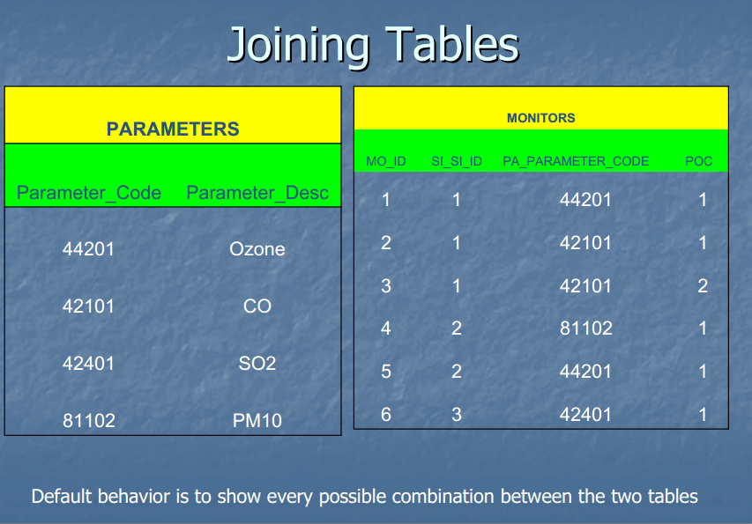

Slide 58
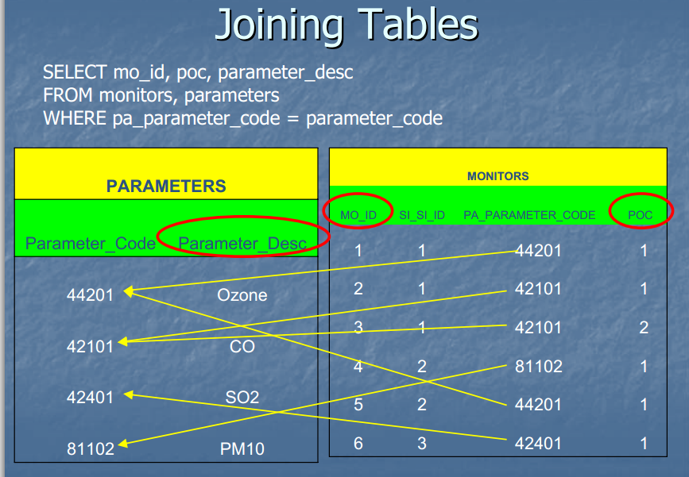

Slide 59


Slide 60
SQL: Foreign Key Constraint(Referential Integrity Constraints)
bname
bname
Referencing
Relation
(e.g. loan)
x
Referenced
Relation
(e.g. branch)
parent
x
x
child
In SQL:
CREATE TABLE branch(
bname CHAR(15) PRIMARY KEY
....)
CREATE TABLE loan (
.........
FOREIGN KEY bname REFERENCES branch);
Affects:
1) Insertions, updates of referencing relation
2) Deletions, updates of referenced relation

Slide 61
Referential Integrity Constraints
c
c
t_{i}
x
parent
t_{j}
x
x
child
what happens when
we try to delete
this tuple?
A
B
Ans: SQL allows the following possibilities
No action
RESTRICT: reject deletion/ update
SET TO NULL: set t_{i} [c], t_{j}[c] = NULL
SET TO DEFAULT: set ti [c], tj[c] = default_val
CASCADE: propagate deletion/update
DELETE: delete ti, tj
UPDATE: set ti[c], tj[c] to updated values

Slide 62
Referential Integrity Constraints
c
c
t_{i}
x
t_{j}
x
x
what happens when
we try to delete
this tuple?
Emp
Dept
ALTER TABLE Dept ADD Primary Key (deptno);
ALTER TABLE Emp ADD FOREIGN KEY (Deptno)
REFERENCES Dept(Deptno) [ACTION];
Action: 1) ON DELETE NO ACTION
left blank (deletion/update rejected)
2) ON DELETE SET NULL/ ON UPDATE SET NULL
sets ti[c] = NULL, tj[c] = NULL
3) ON DELETE CASCADE
deletes ti, tj
4) ON UPDATE CASCADE
sets ti[c], tj[c] to new key values

Slide 63
Points to remember while creating table
Creates a table with one or more columns of the specified dataType.
With NOT NULL, system rejects any attempt to insert a null in the column.
Can specify a DEFAULT value for the column.
Primary keys should always be specified as NOT NULL.
FOREIGN KEY clause specifies FK along with the referential action

Slide 64
Summary of SQL Queries (cont.)
The SELECT-clause lists the attributes or functions to be retrieved
The FROM-clause specifies all relations (or aliases) needed in the query but not those needed in nested queries
The WHERE-clause specifies the conditions for selection and join of tuples from the relations specified in the FROM-clause
GROUP BY specifies grouping attributes
HAVING specifies a condition for selection of groups
ORDER BY specifies an order for displaying the result of a query
A query is evaluated by first applying the WHERE-clause, then GROUP BY and HAVING, and finally the SELECT-clause

